Slide 1
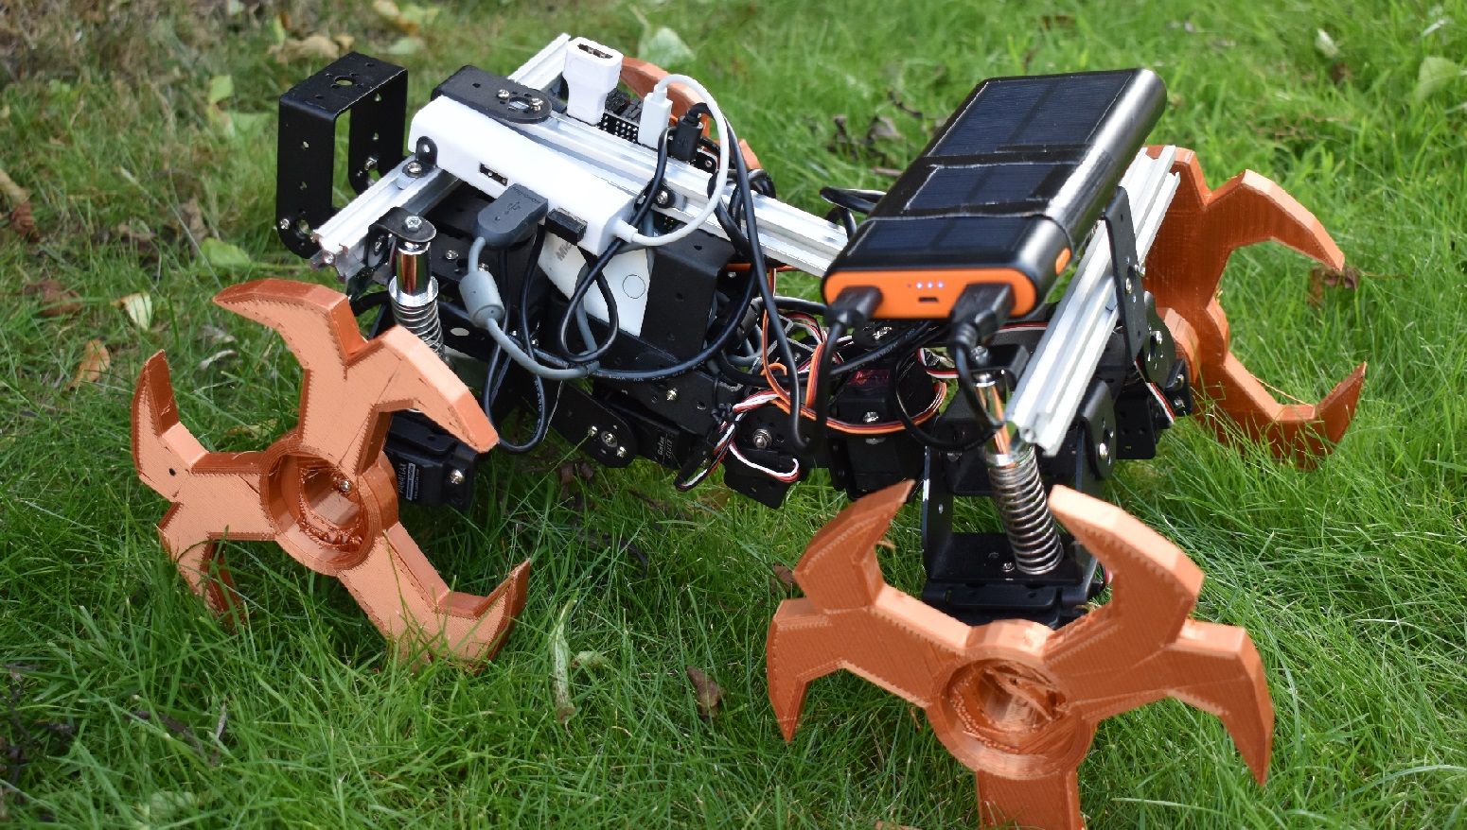
Bio-Inspired Navigation on Varied Terrain
Dexter Shepherd

Slide 2
Aims of the project
Use inspiration from nature to make a more resilient chassis
Explore methods of enabling an agent to understand its own limitations
Attempt to cross the reality gap from simulated terrain avoidance to physical robotics

Slide 3
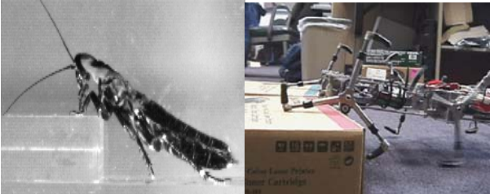
Inspiration
Cockroach locomotion
Project PROLERO

Slide 4
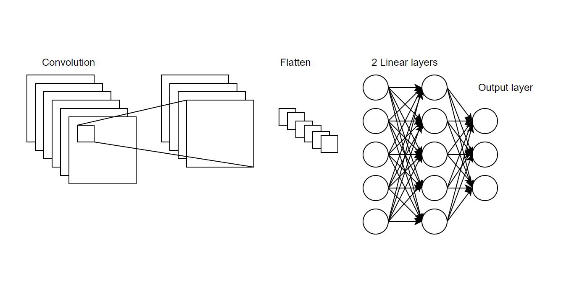
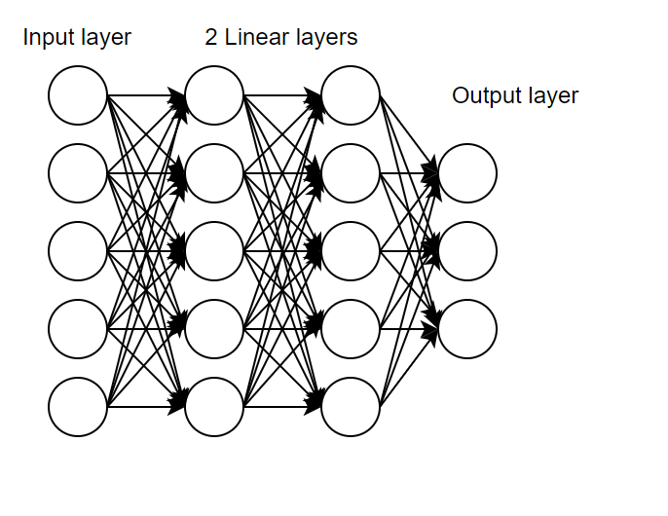
Genetic approach
Used due to large search space and no training data
Trialled different algorithms and network architectures
Microbial
Group evolution
Conv1D
Conv2D
Feed forward
Comparison with rule based approach

Slide 5
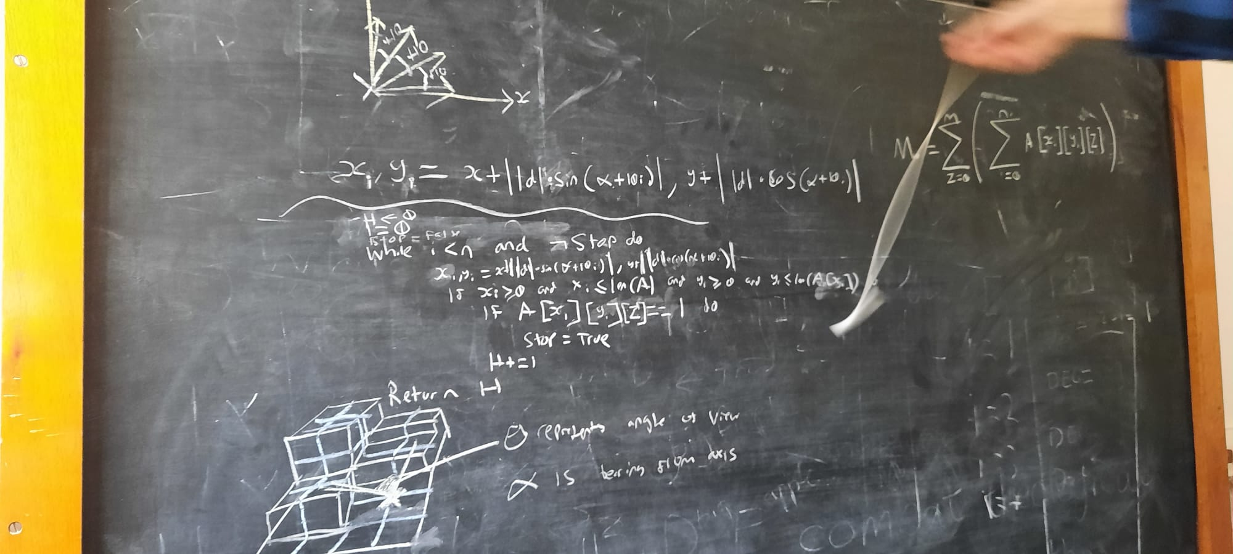
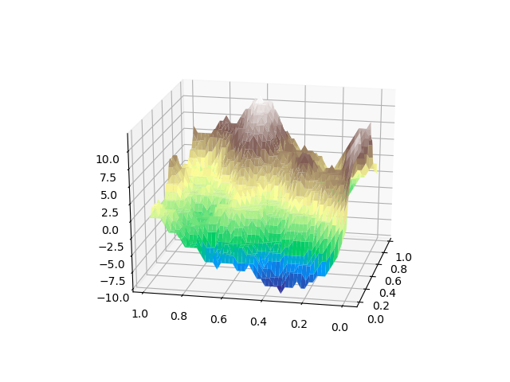
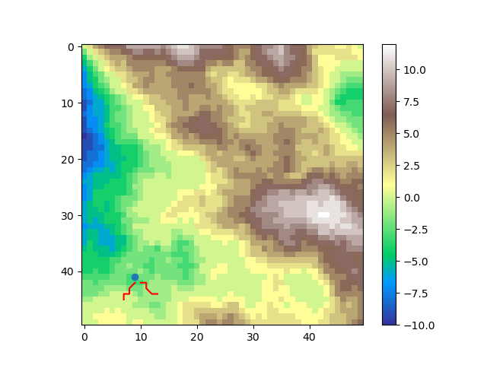
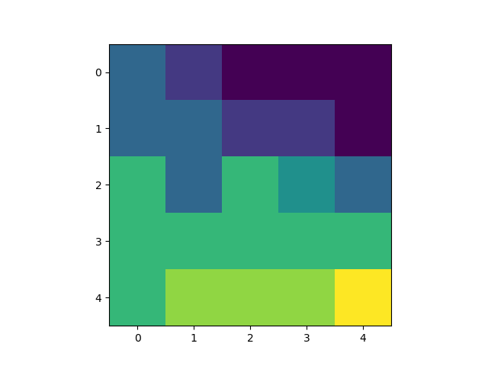

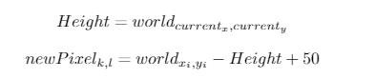
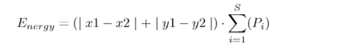
Simulation
Procedurally generated terrain
First person view
Fitness determined by energy and collision

Slide 6
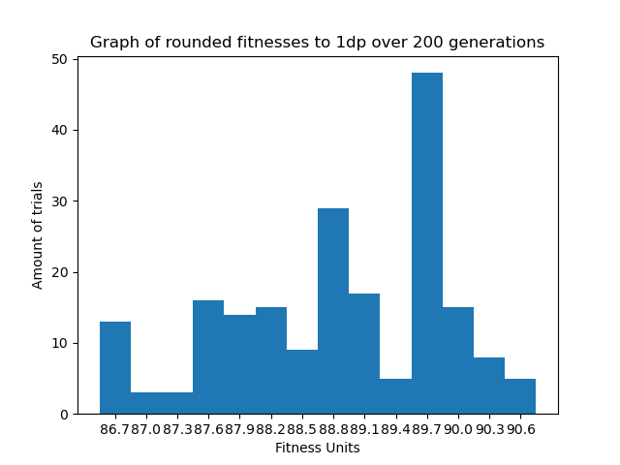
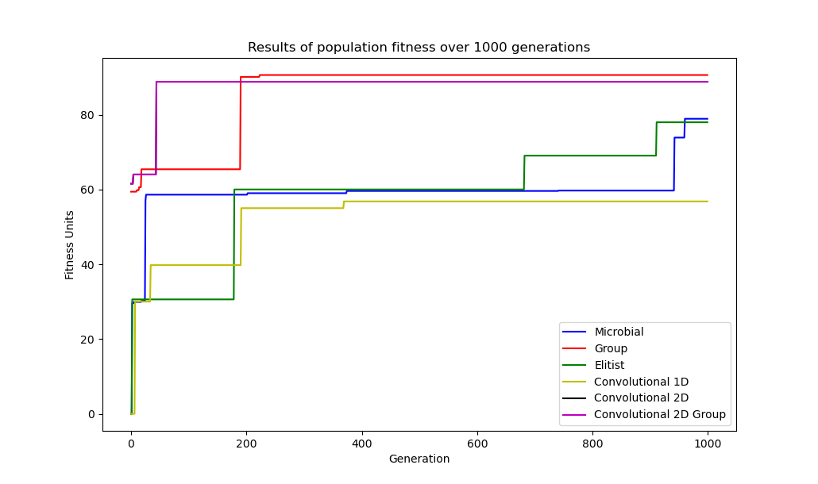
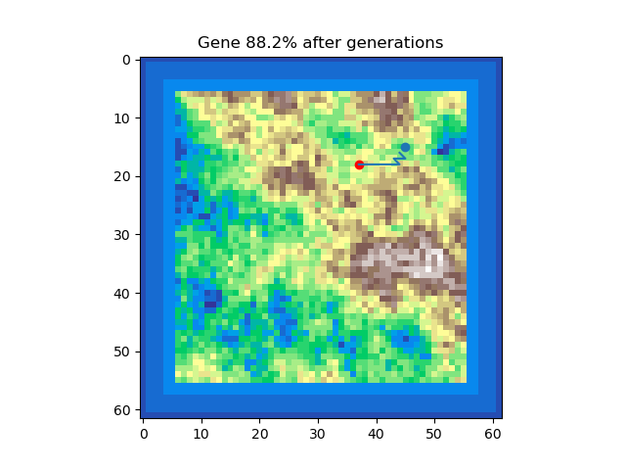
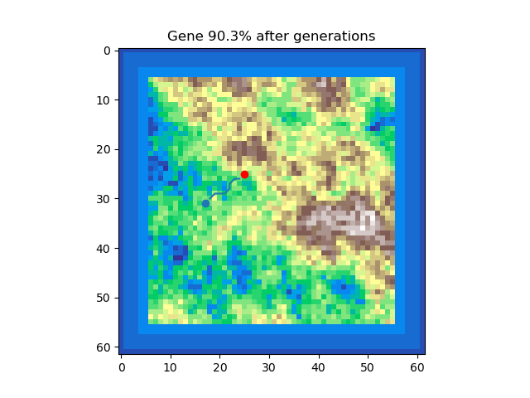
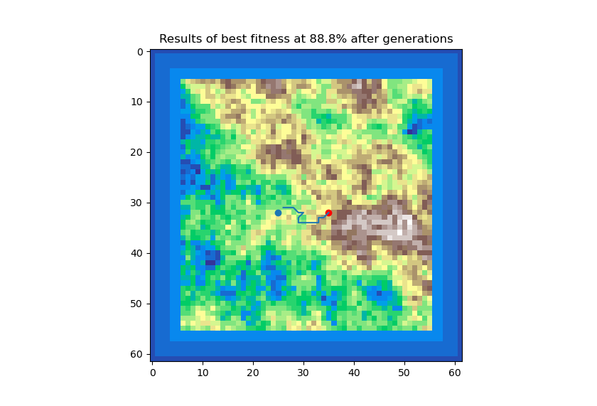
Simulation results
Performed best with a 2D convolutional neural network
Rule based approach outperformed evolution
Evolved to use contours
FNN Microbial
Rule based
CNN Microbial

Slide 7
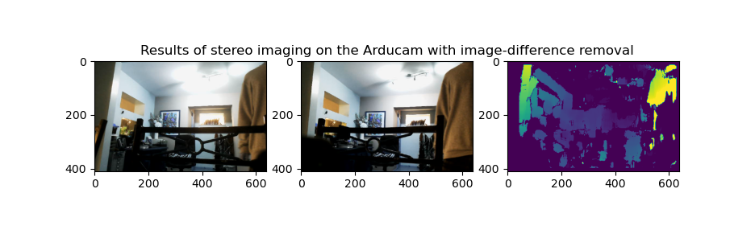
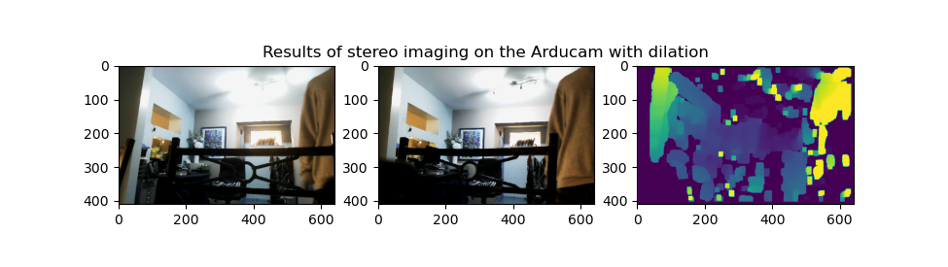
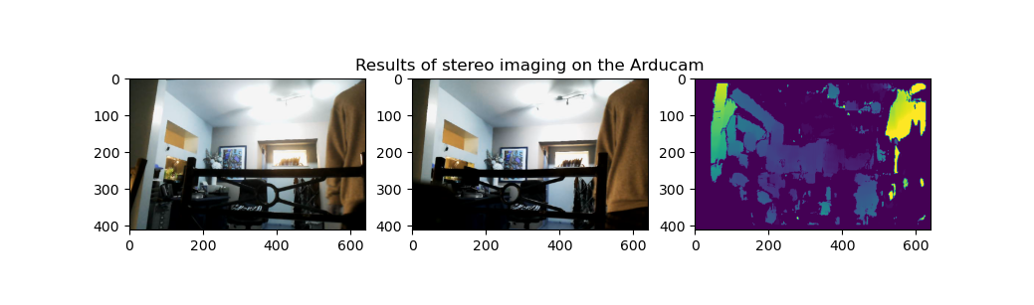
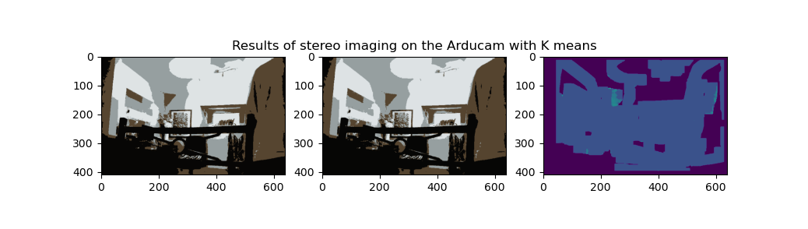
Computer vision
Stereo vision
Pre-processing testing
Off-the-shelf Kinect

Slide 8
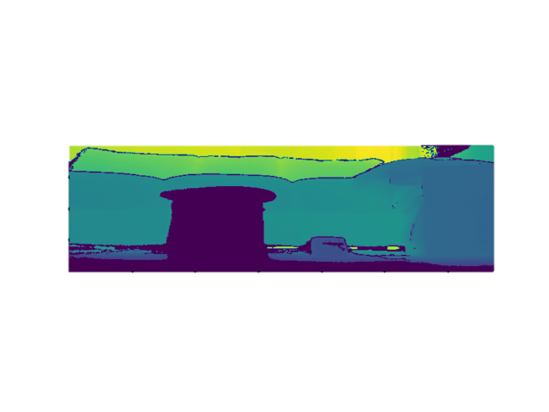
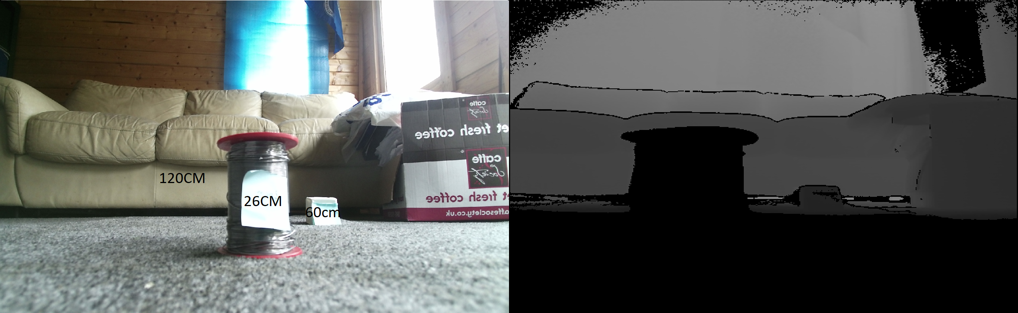

Rule based visual approach
Image cropped to remove depth of floor
$\sum_{i=1}^{n}{{\sum_{i=1}^{m}{{Pixels}_{ji}}}_{}}, where n and m are an interval$
Rule based approach finds the least amount of dark pixels

Slide 9
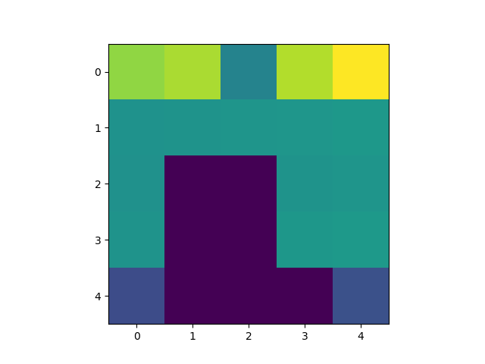
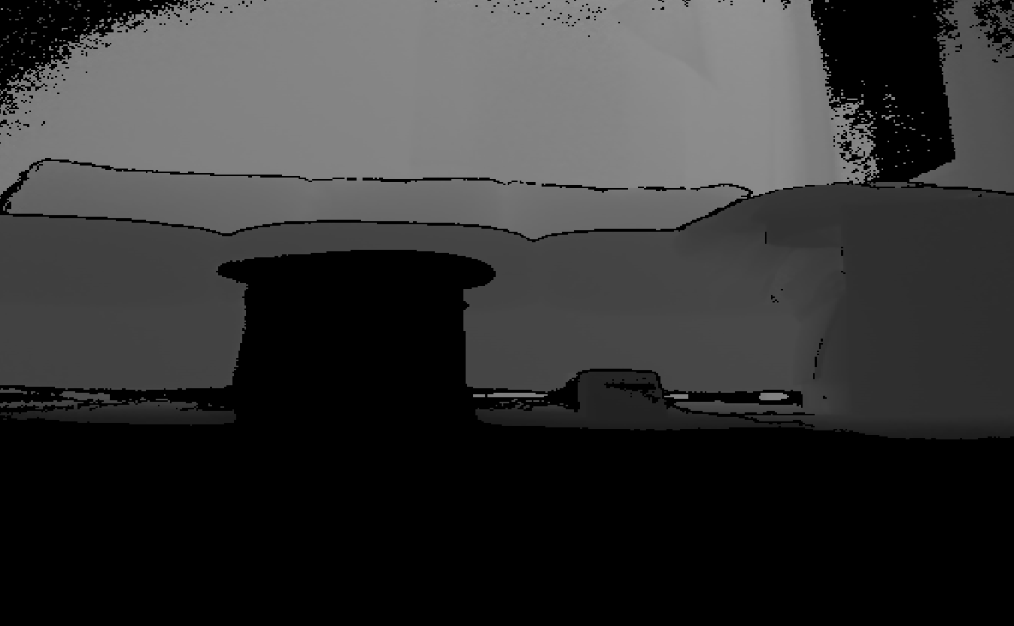
Crossing the reality gap
Applying trained model on the vision
Visual compression

Slide 10
Results of crossing the reality gap

Slide 11
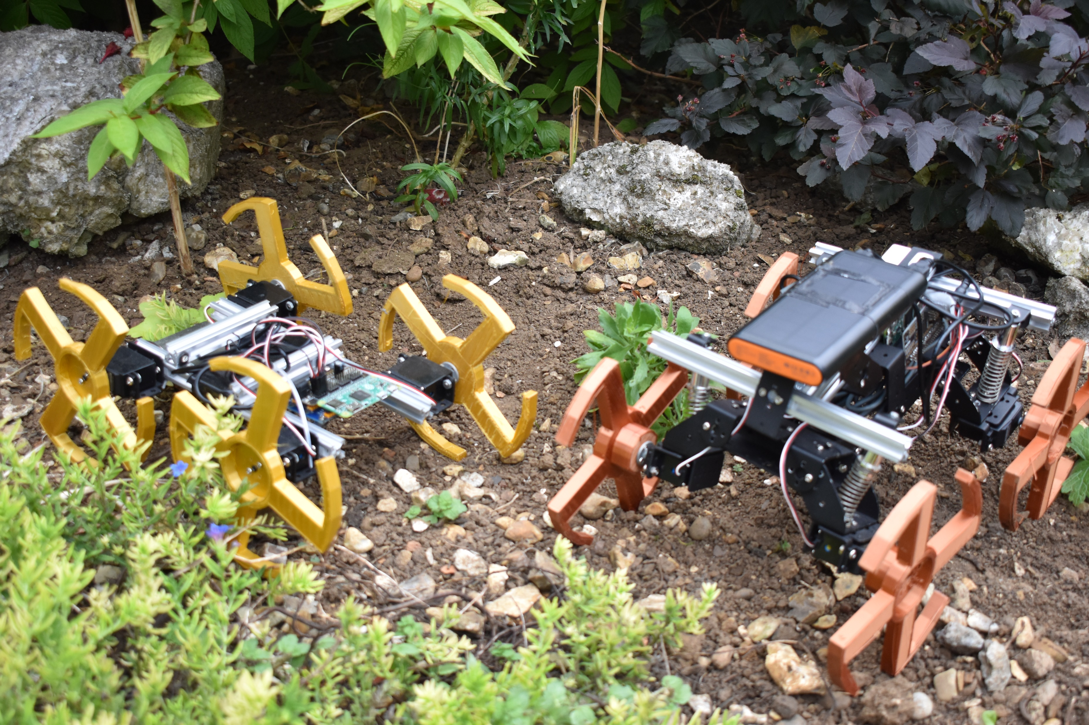
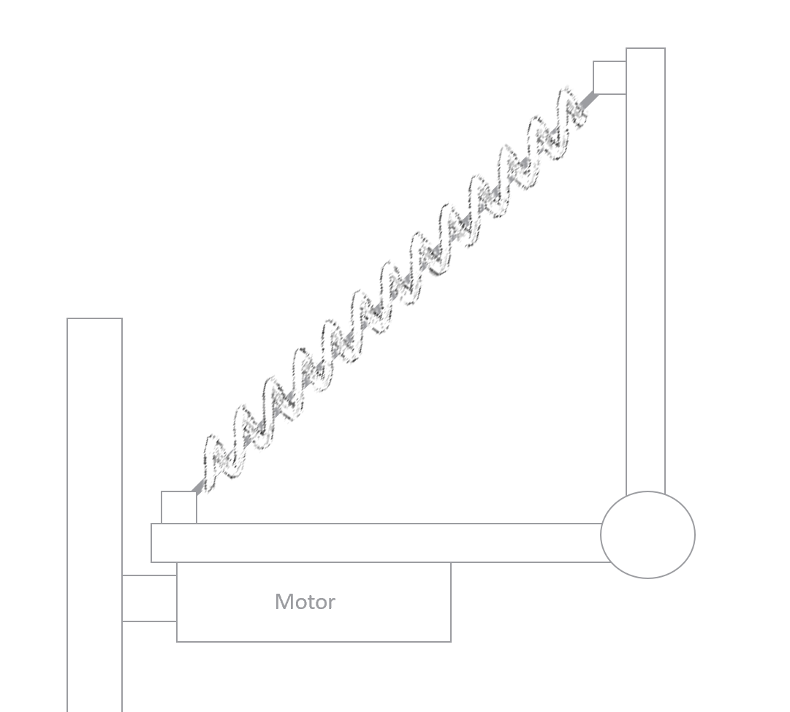
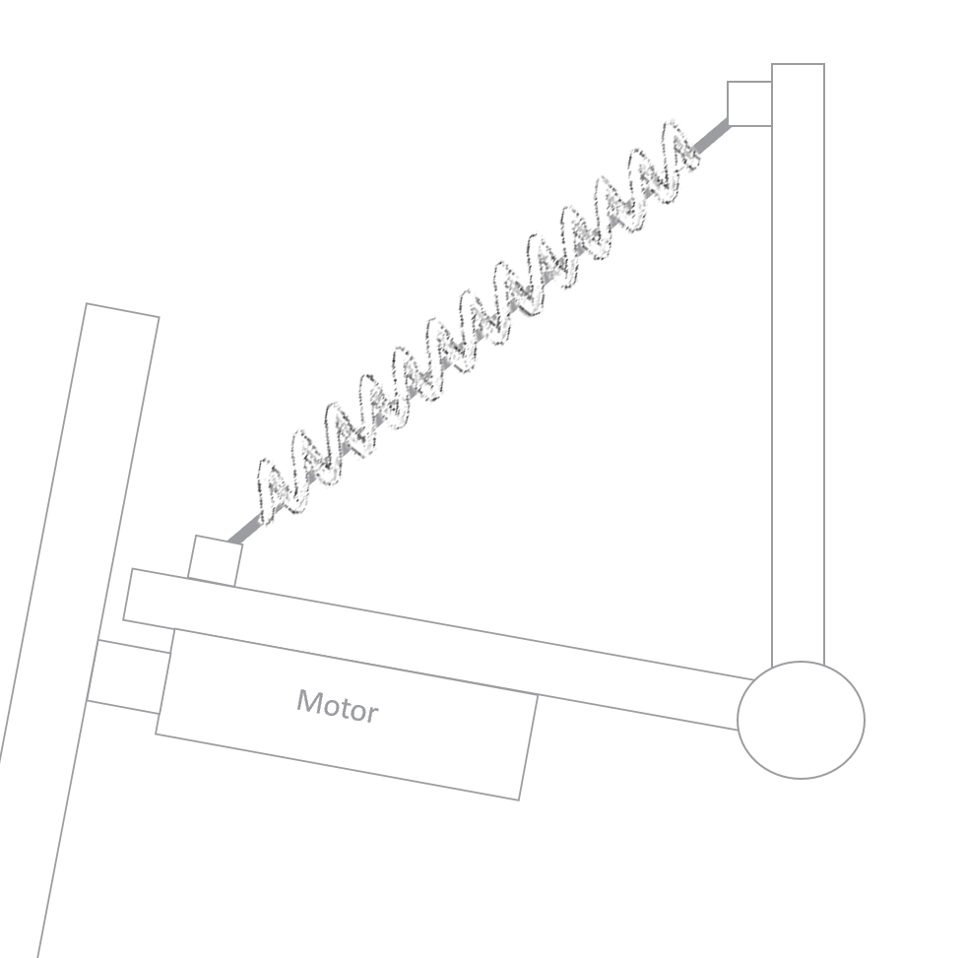
Physical robot implementation
Version 1 – no back bending
Version 2 – Back bending and suspension
Version 3 – Better rotating and improved Whegs
All using the Raspberry Pi Zero

Slide 12
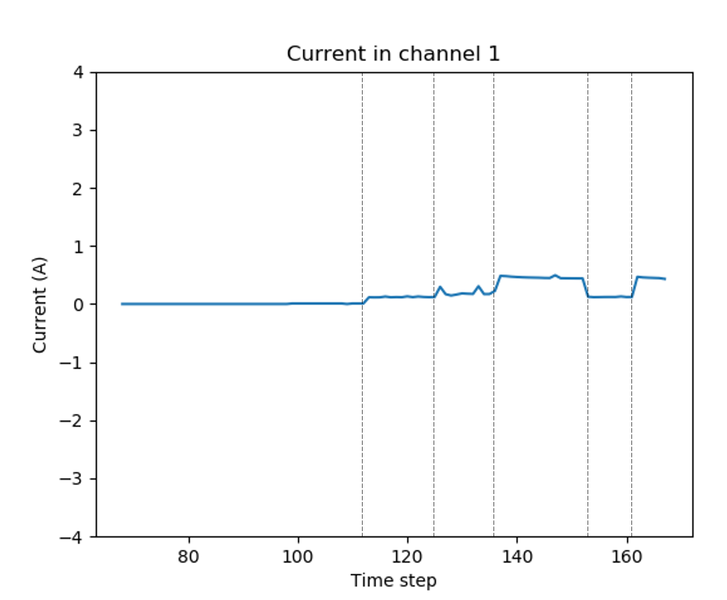
Proprioception (getting stuck)
Current draw
Standard servo draw of 0.1A
Thresholding (greater than 0.4A)

Slide 13
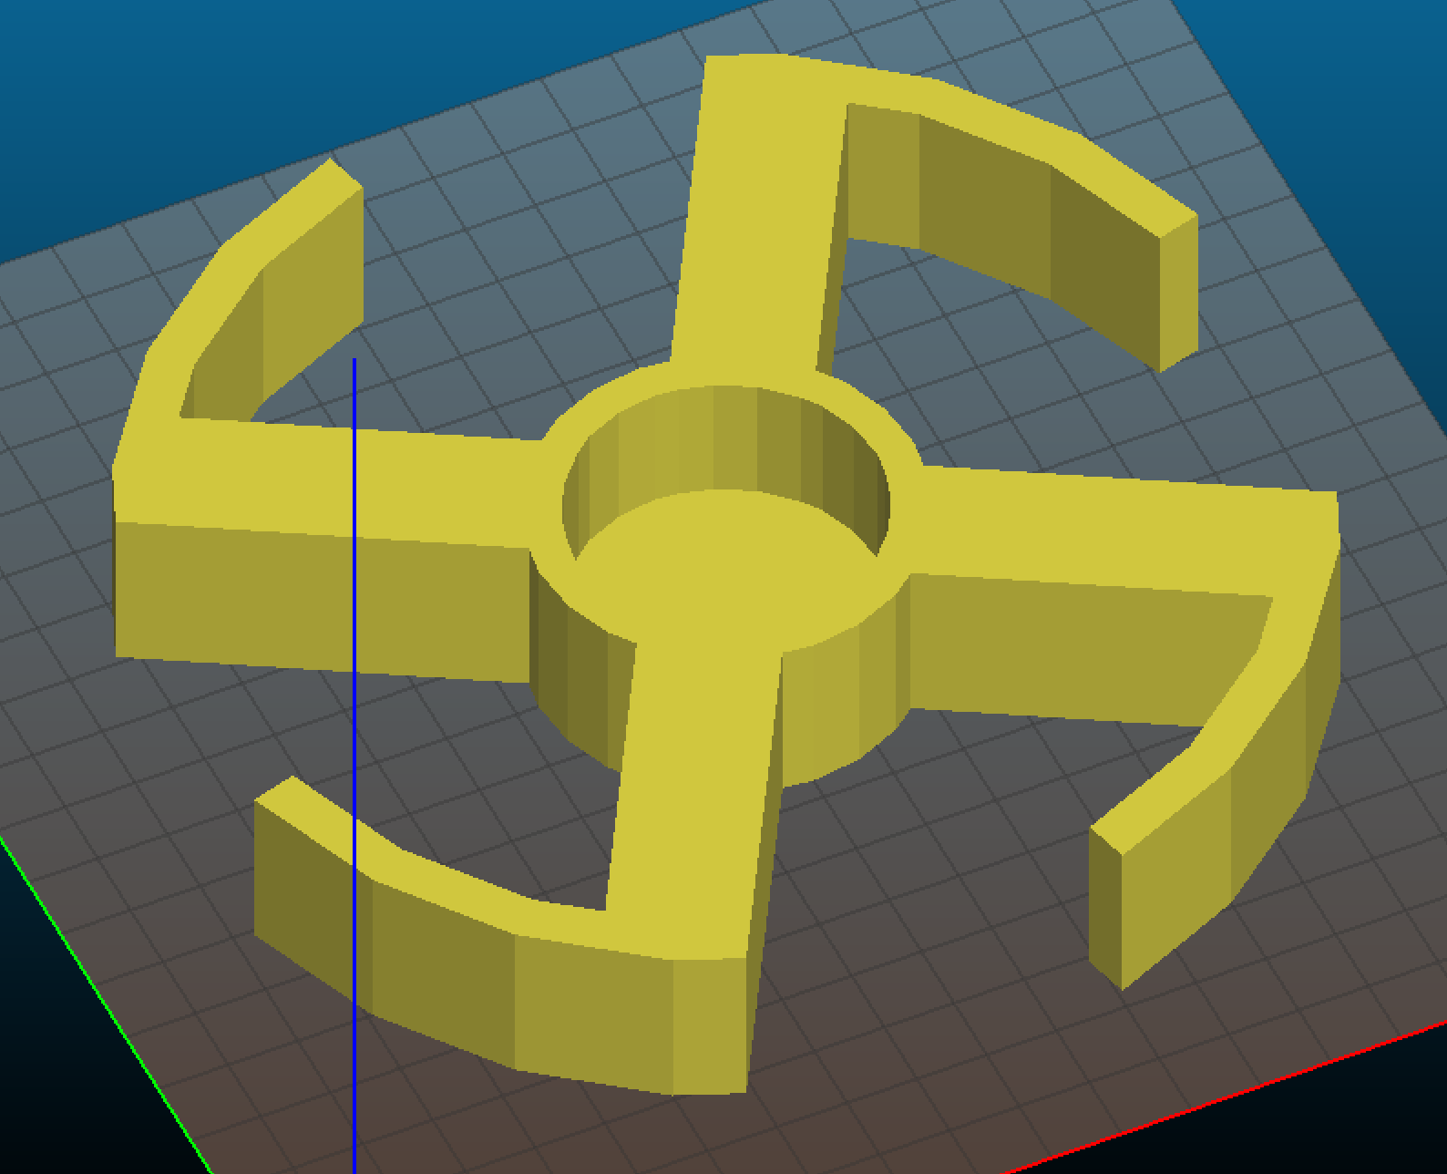
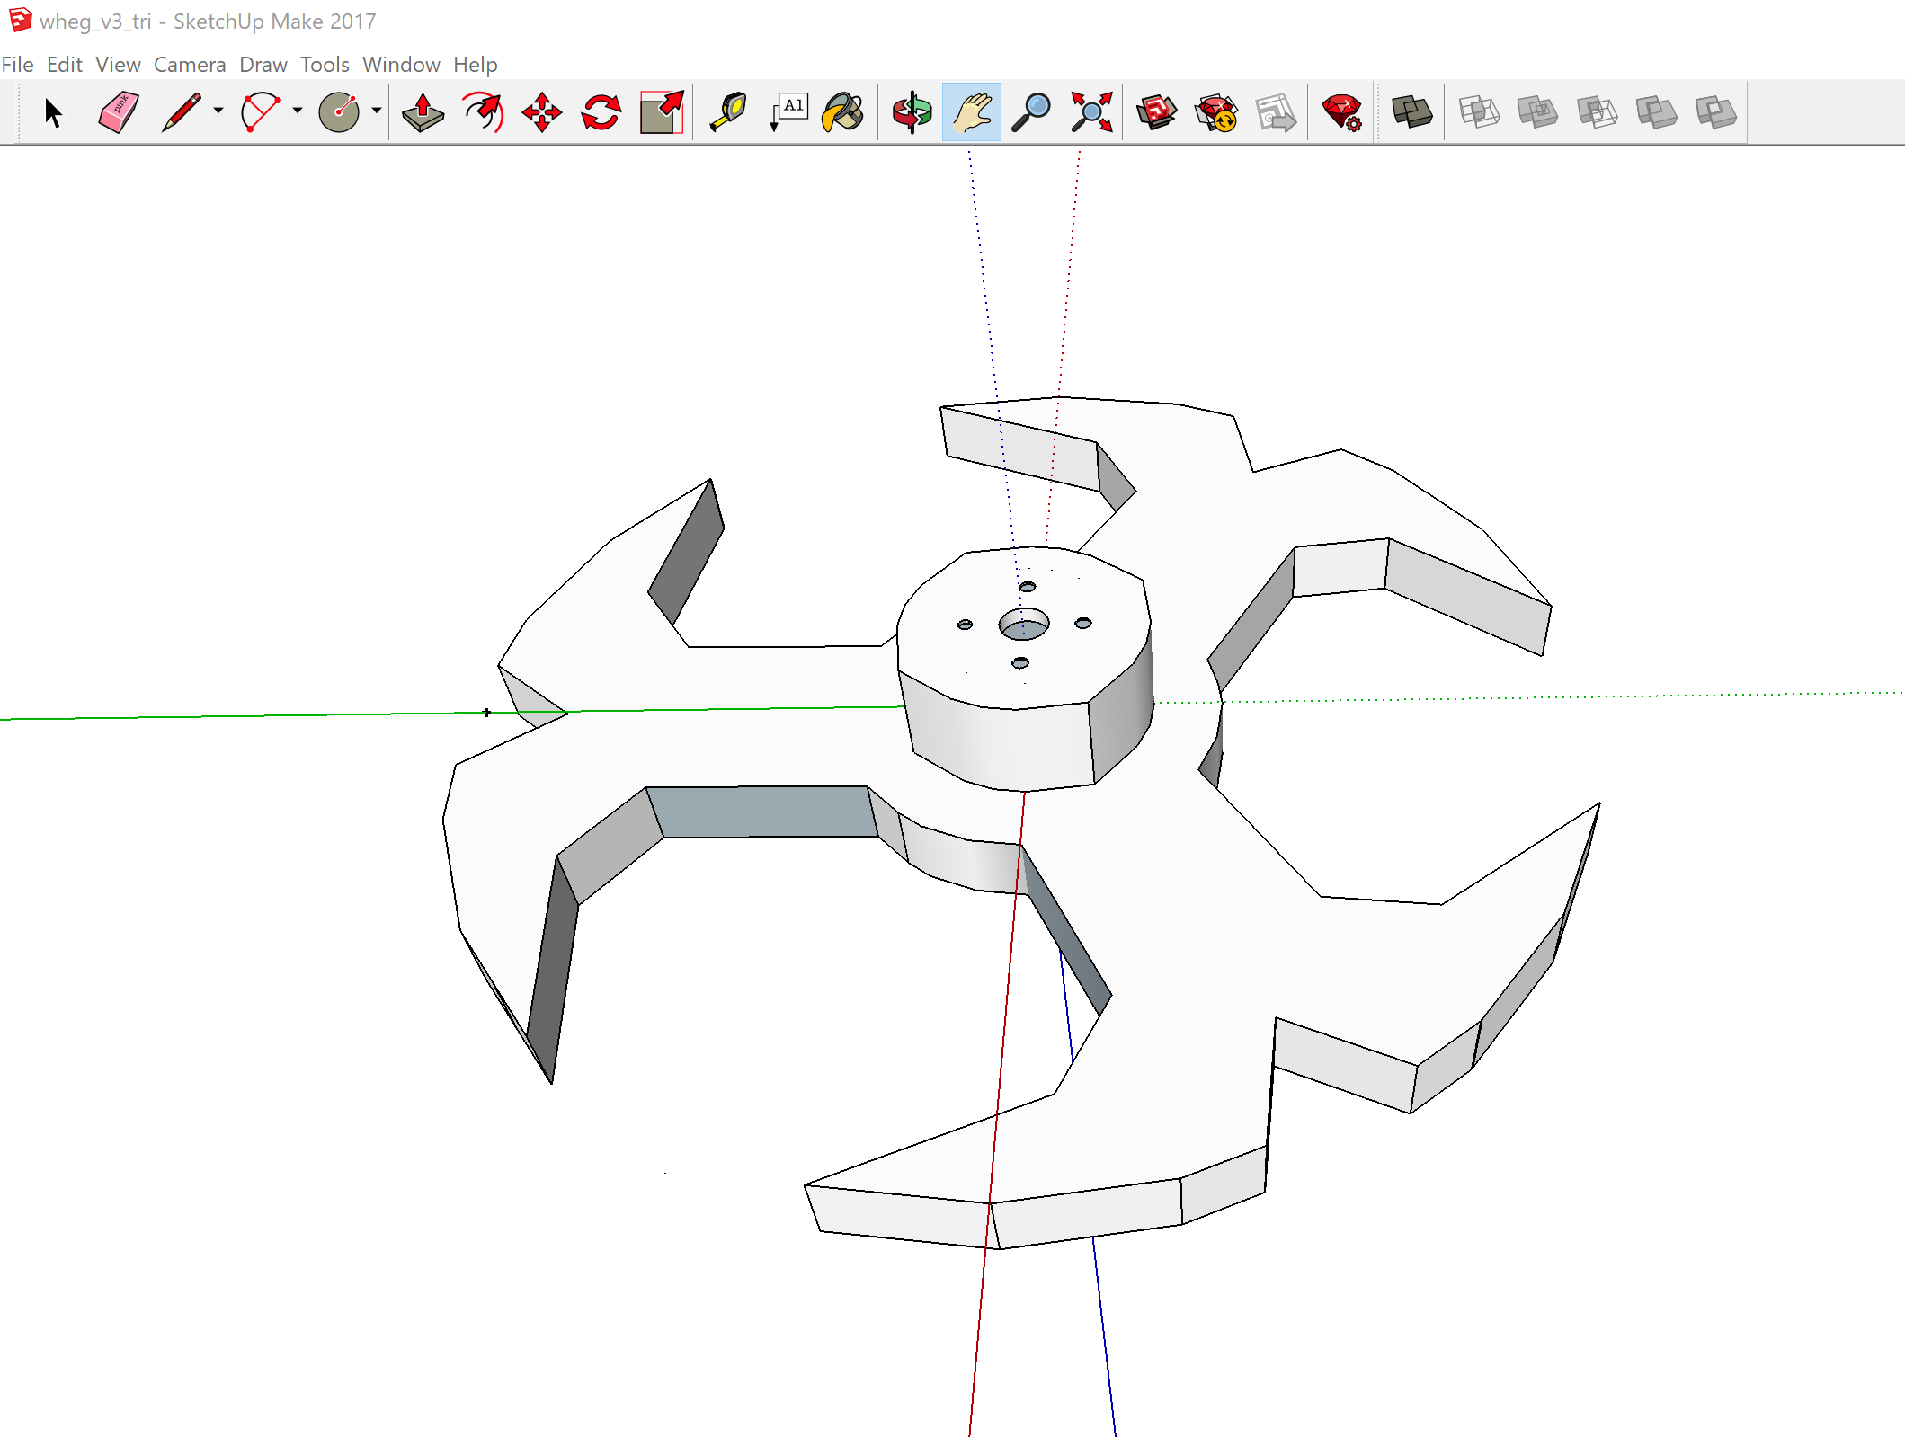
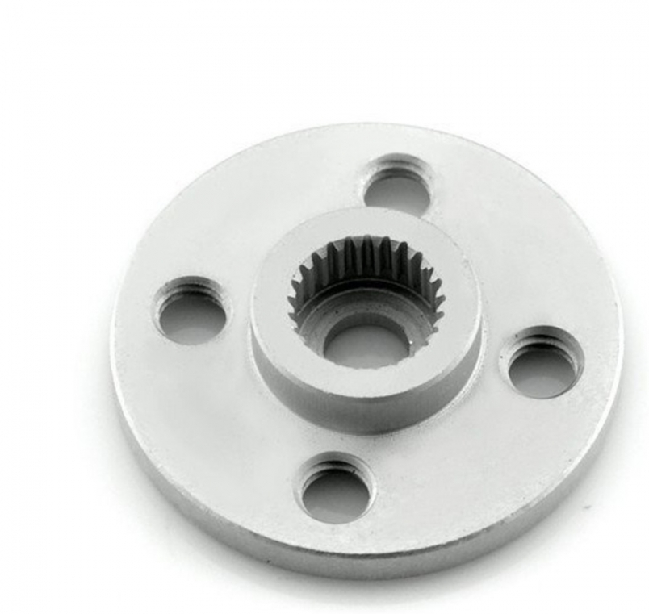
Wheg design
3D printed Whegs
CAD designed on SketchUp

Slide 14
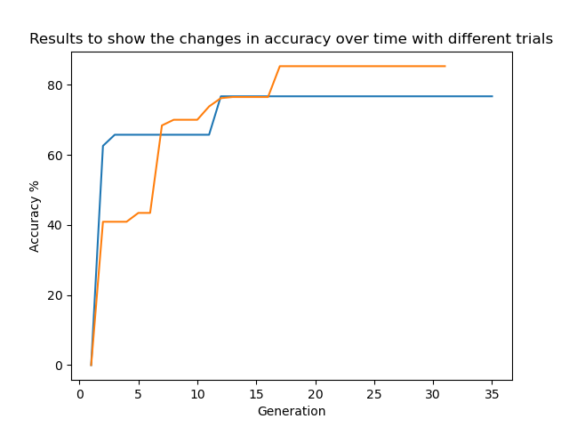
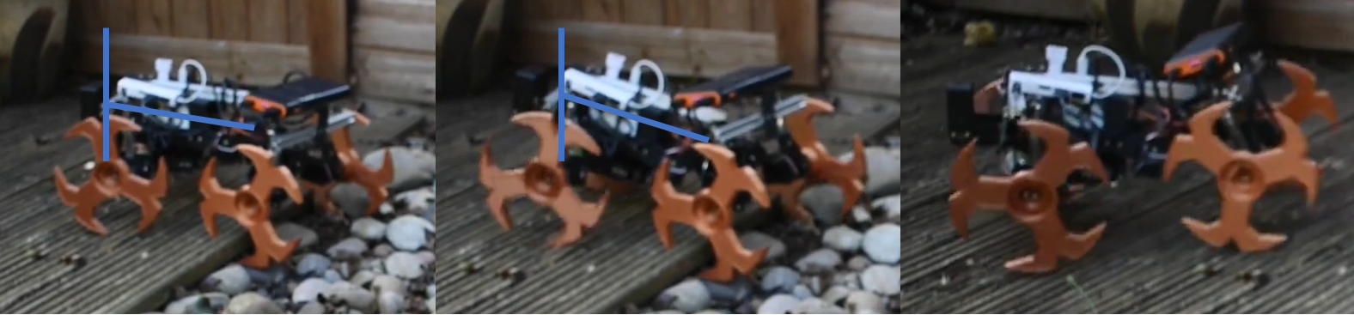
Back bending
Inspired from cockroaches
Evolved solution (hillclimber)
Quick convergence on solution

Slide 15
Conclusions
Simulation showed proof of concept for evolved navigation
Back bending improved locomotion
Best model was group, however rule based was more trustworthy

Slide 16
Future work
More compact onboard stereo sensors
Lighter chassis and Jetson instead of Raspberry Pi

Slide 17
References
Nicholas Tomko, Inman Harvey, Nathaniel Virgo, and Andrew Philippides. Many hands make light work: Further studies in group evolution. Artificial Life, 20(1):163–181, 2014
European Space Agency. Prolero. https://www.esa.int/Enabling_Support/Space_Engineering_Technology/Automation_and_Robotics/PROLERO
R.T. Schroer, M.J. Boggess, R.J. Bachmann, R.D. Quinn, and R.E. Ritzmann. Comparing cock- roach and whegs robot body motions. In IEEE International Conference on Robotics and Au- tomation, 2004. Proceedings. ICRA ’04. 2004, volume 4, pages 3288–3293 Vol.4, 2004.

